Slide 1
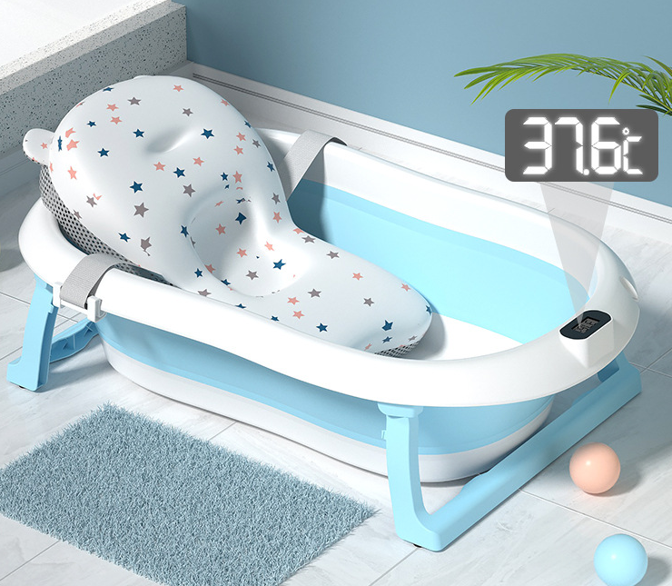
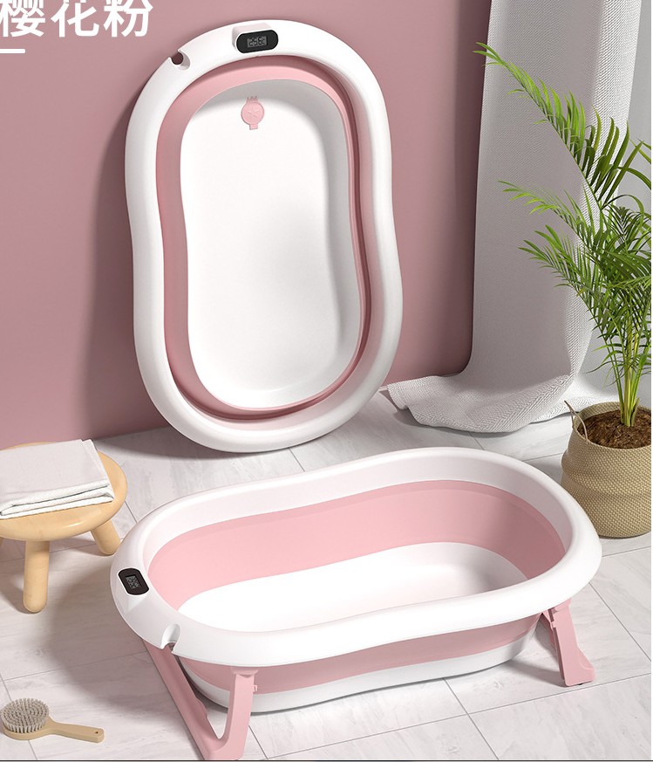
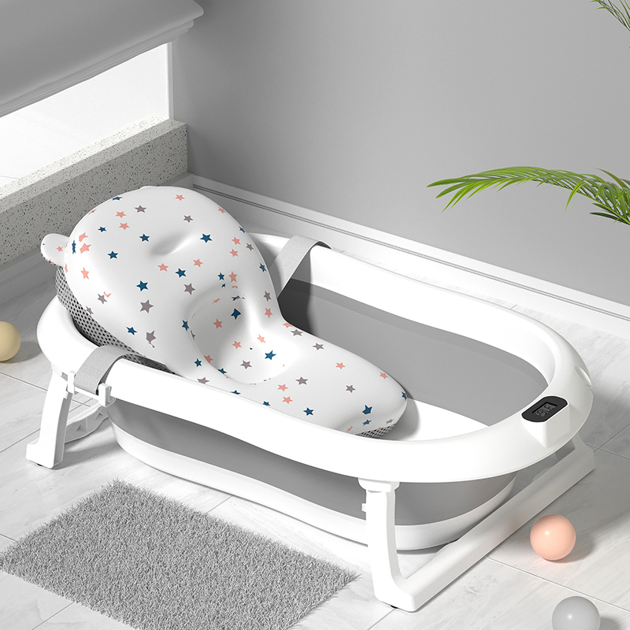
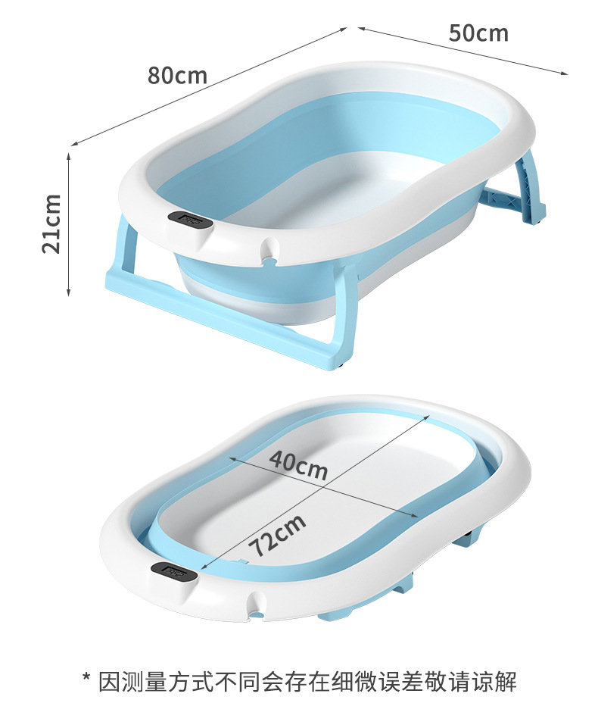

HB感温浴盆
HB temperature-sensing bathtub
净重：1.6KG
Net weight: 1.6KG
包装细节：OPP袋子装+入纸箱
Packing details: OPP bag+carton
包装尺寸：81*50*10CM
Packing size: 81*50*10CM
毛重：2.35KG
Grossweight:2.35KG
装箱数：1件
Packing number: 1 piece
单件体积：0.0402m³
Single volume: 0.0402m³
颜色：如图所示
Color: As shown in the figure
定制颜色：单色整柜的数量起
Custom color: from the quantity of single color cabinet.
产品尺寸：80X51*22CM
Dimensions: 80X51X22CM
执行标准：Q/HYHB 005
Implementation standard: Q/HYHB 005
40Q高柜装货数量：1680套
40Q high container loading quantity: 1680 sets
材质：pp+tpe
Material: pp+tpe
备注：以上报价均是单个空盆，不含浴网.浴垫
Remarks: the above quotation is a single empty basin, excluding bath net, bracket and bath pad

