Slide 1
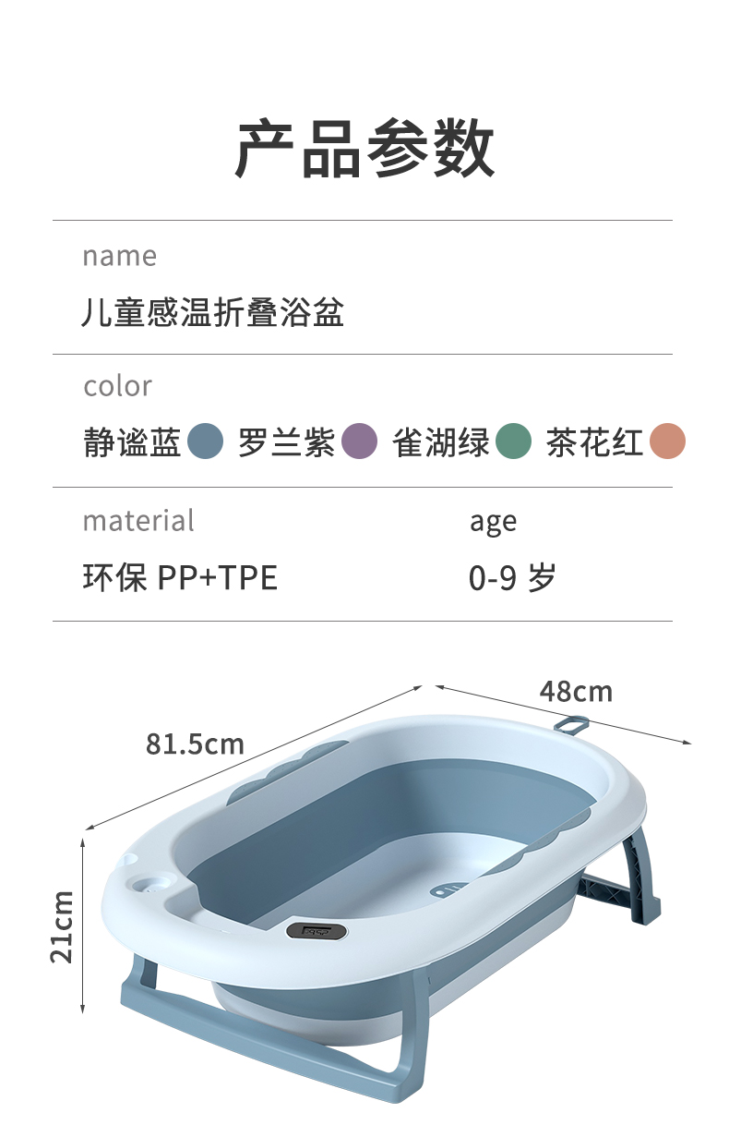
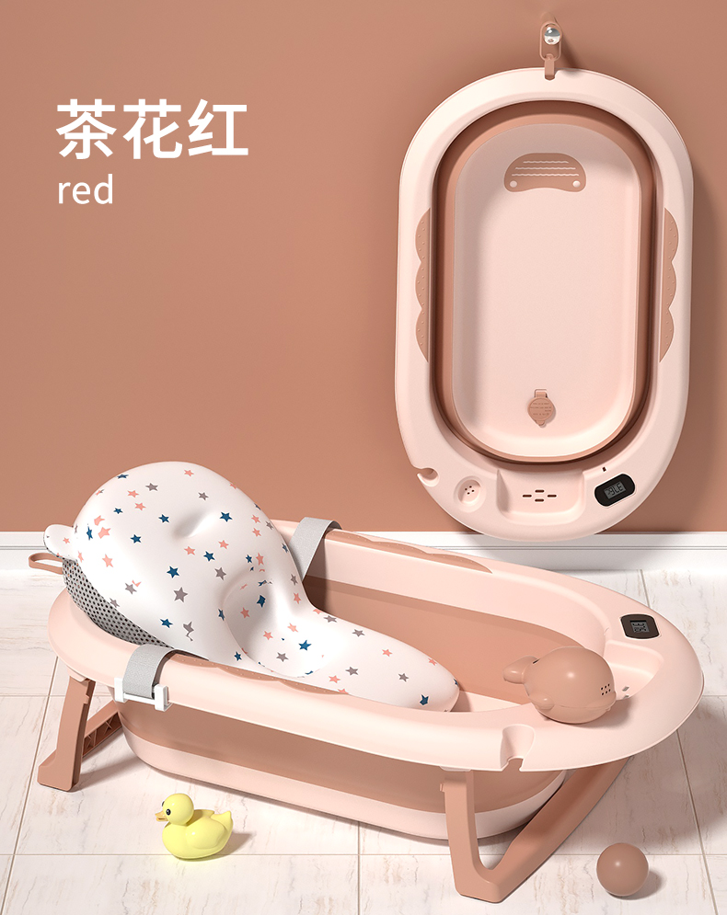
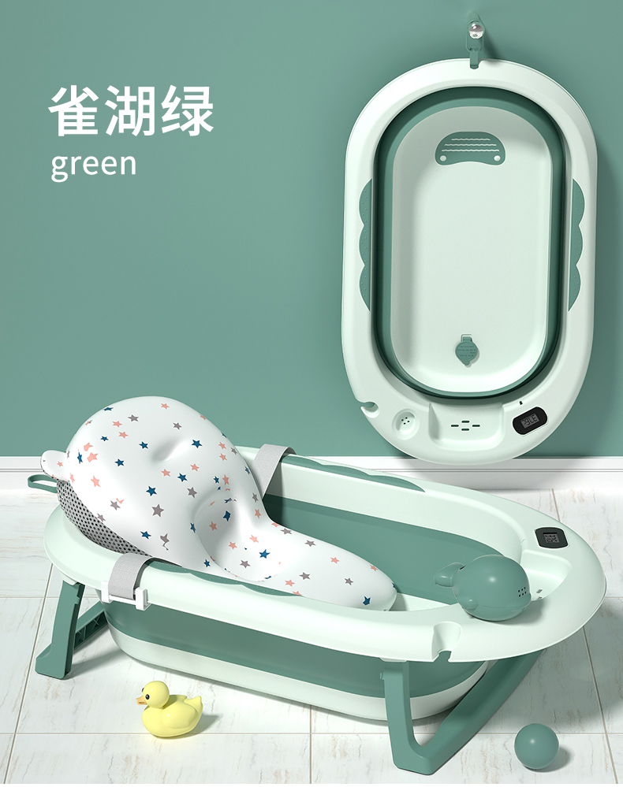
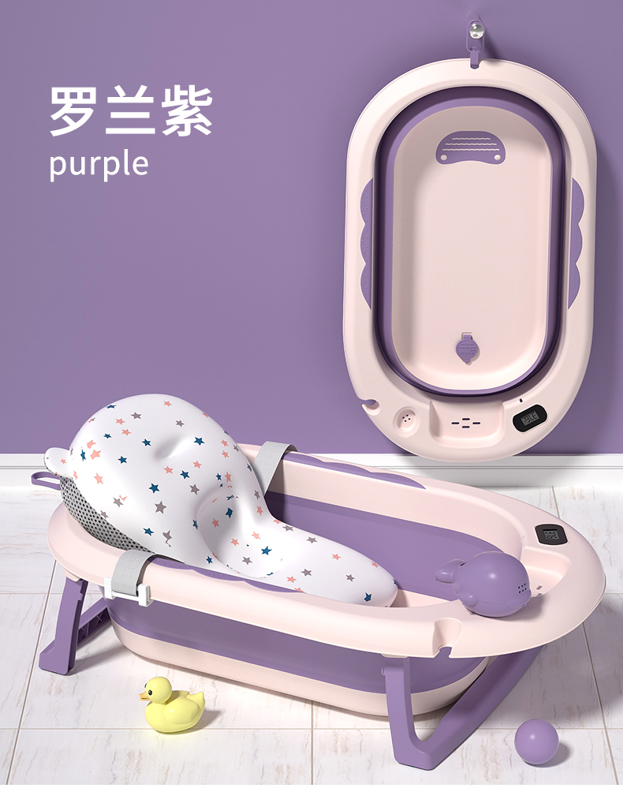
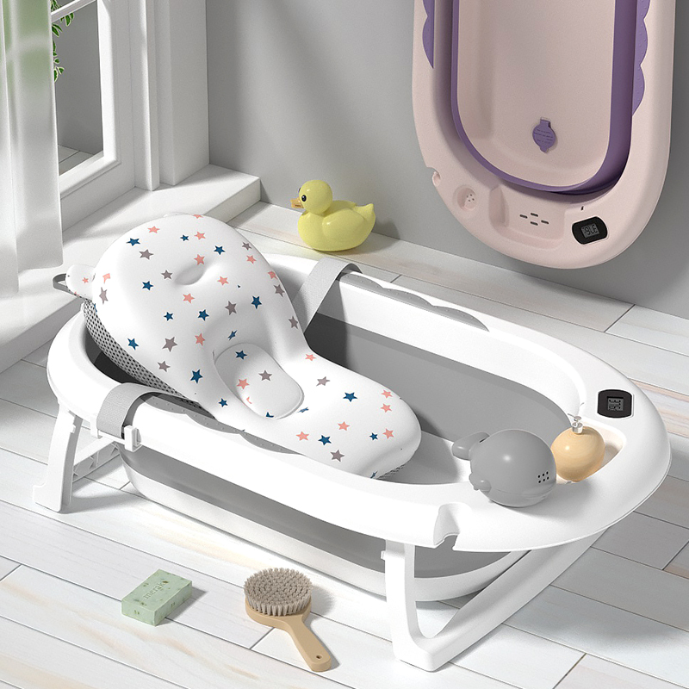
品名：JYGW浴盆
Name: JYGW bathtub
超级新品
Super new product
材质：PP+TPE
Material: PP+TPE
产品展开尺寸：81*49*21cm
Expanded product size: 81*49*21cm
产品折叠尺寸：81*49*9cm
Folding size: 81*49*9cm
包装尺寸：82*49*10
Packing: 82*49*10
装箱数：1件
Packing number: 1 piece
单件体积：0.0402m³
Single volume: 0.0402m³
40Q高柜装货数量：1680套
40Q high container loading quantity: 1680 sets
净重：1.45KG
Net weight: 1.45KG
定制颜色：单色整柜的数量起
Custom color: from the quantity of single color cabinet.
执行标准：Q/HYHB 005
Implementation standard: Q/HYHB 005
毛重：1.95kg
Gross weight: 1.95kg
备注：报价包含水温计+花洒杯子；不含浴垫
Remarks: The quotation includes water temperature meter+shower cup; Bath pad not included

