Slide 1
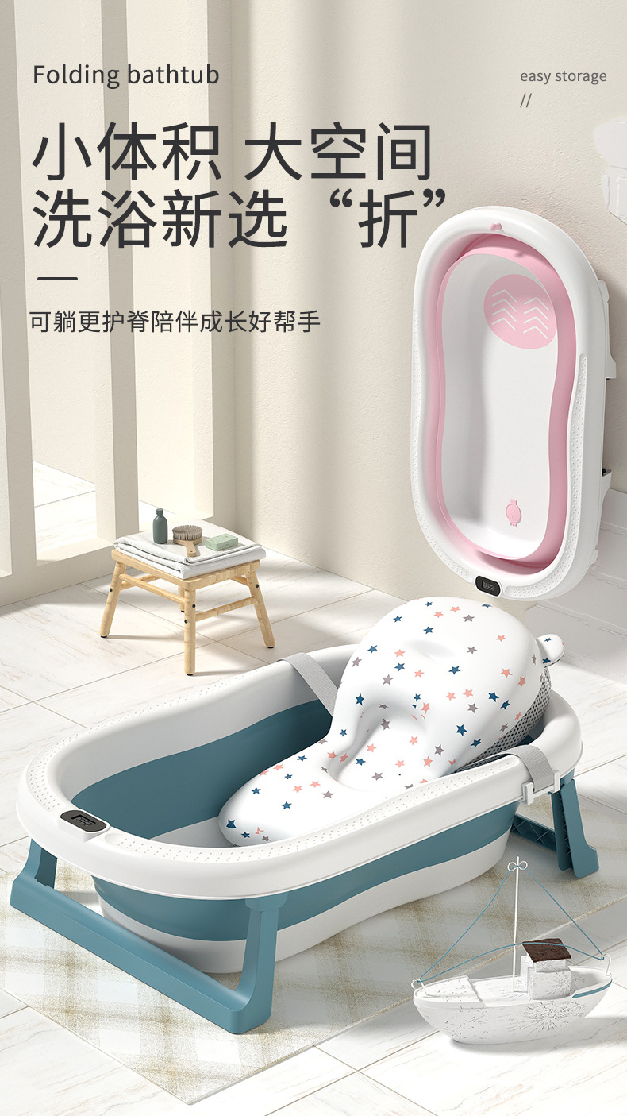

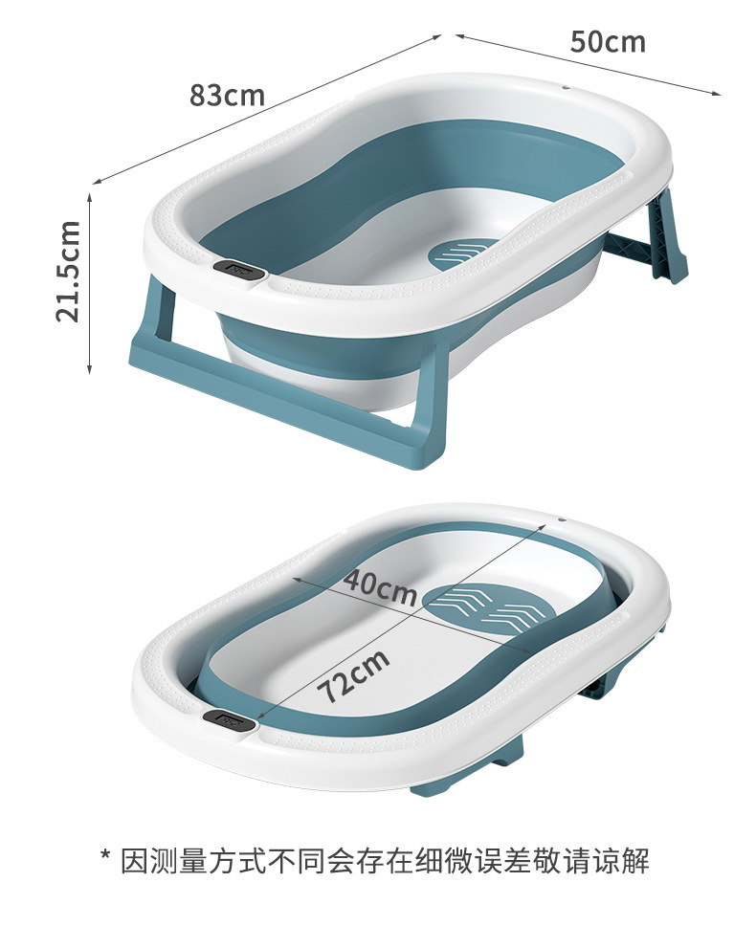
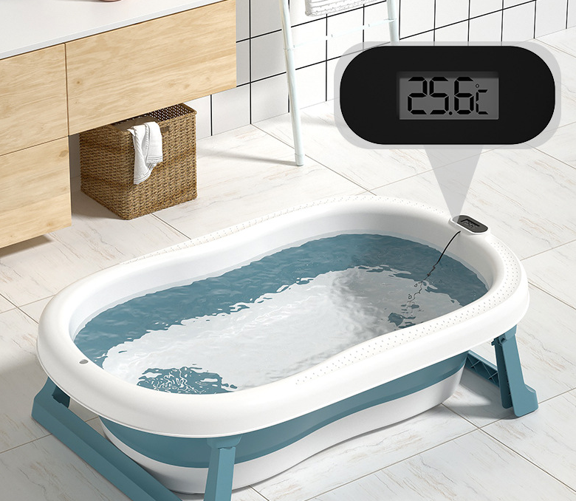
豪华感温浴盆
Luxury temperature-sensing bathtub
净重：2.3KG
Net weight: 2.3KG
毛重：3KG
Grossweight:3KG
包装细节：OPP袋子装+入纸箱
Packing details: OPP bag+carton
颜色：蓝色/粉色
Color: blue/pink
装箱数：1件
Packing number: 1 piece
执行标准：Q/HYHB 005
Implementation standard: Q/HYHB 005
产品尺寸：83*52*22CM
Dimensions: 83*52*22CM
材质：pp+tpe
Material: pp+tpe
定制颜色：单色整柜的数量起
Custom color: from the quantity of single color cabinet.
包装尺寸：83*52*10CM
Packing size: 83*52*10CM
单件体积：0.0432m³
Single volume: 0.0432m³
40Q高柜装货数量：1500套
40Q high container loading quantity: 1500 sets
备注：以上报价均是单个空盆，不含浴网.浴垫
Remarks: the above quotation is a single empty basin, excluding bath net, bracket and bath pad

