Slide 1
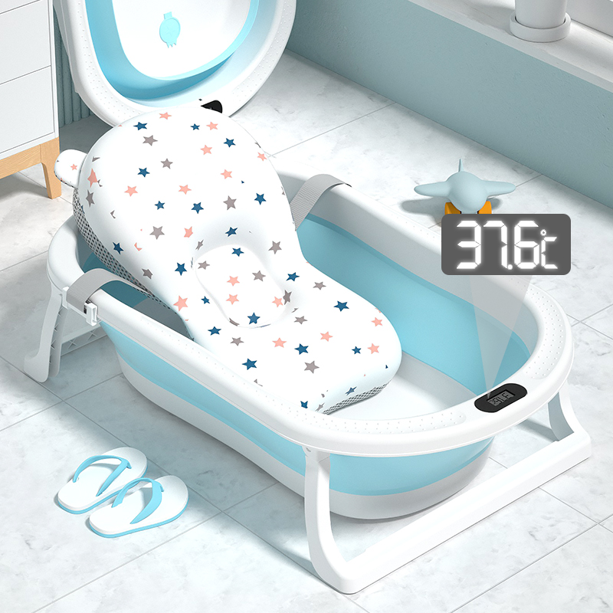
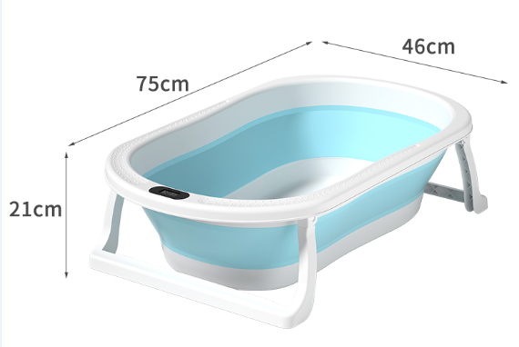
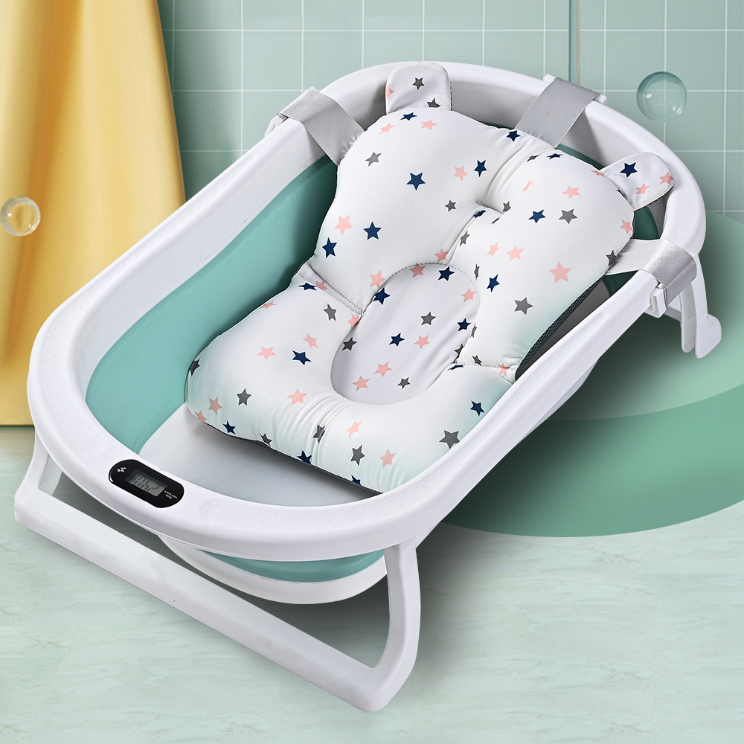
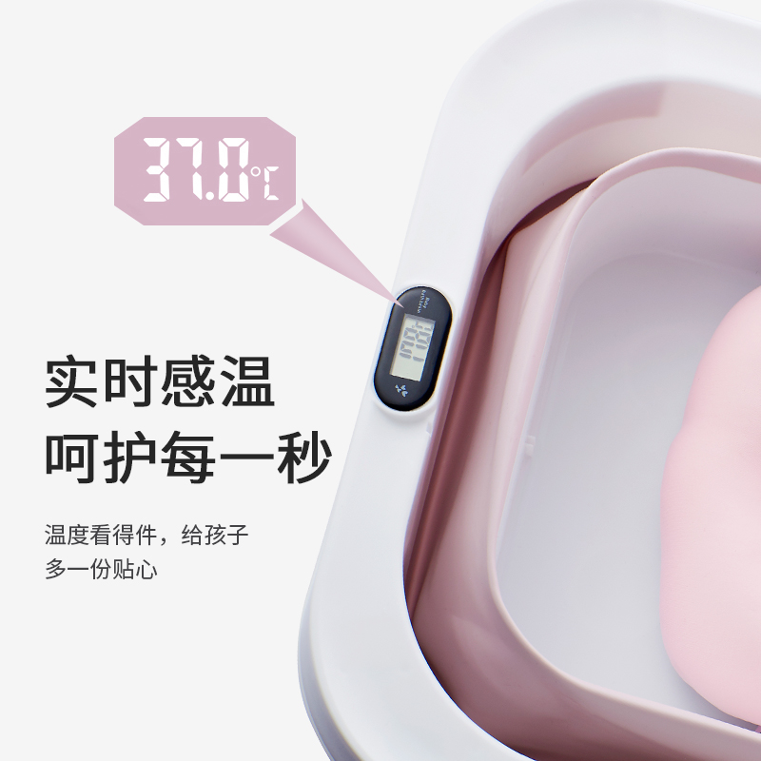

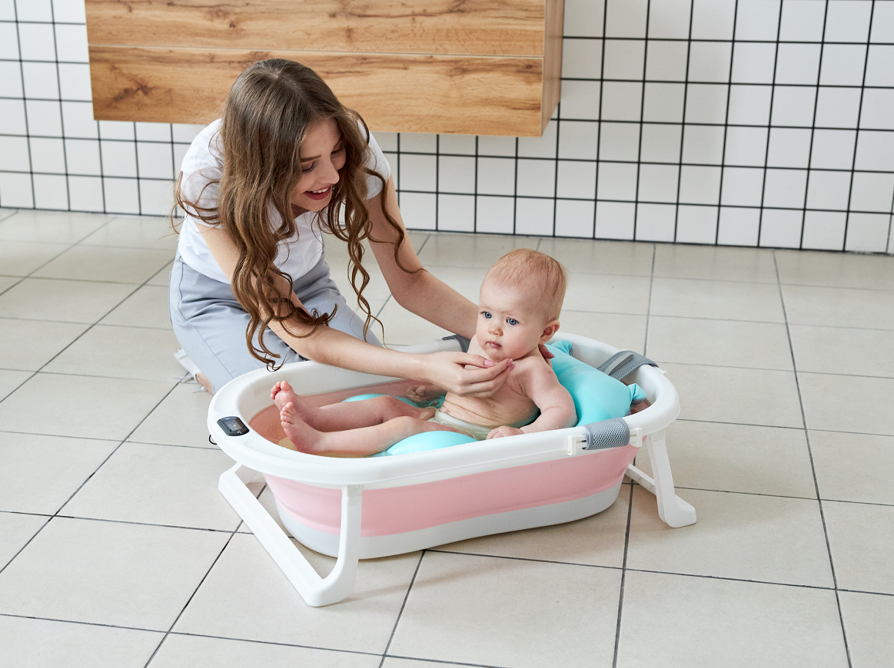
CB温度计浴盆
CB thermometer bathtub
包装细节：OPP袋子装+入纸箱
Packing details: OPP bag+carton
净重：1.35KG
Net weight: 1.35KG
毛重：1.9KG
Grossweight:1.9KG
颜色：蓝色/粉色/绿色
Color: blue/pink/Green
定制颜色：单色整柜的数量起
Custom color: from the quantity of single color cabinet.
包装尺寸：76*47*10CM
Packing size: 76*47*10CM
单件体积：0.0358m³
Single volume: 0.0358m³
装箱数：1件
Packing number: 1 piece
40Q高柜装货数量：1900套
40Q high container loading quantity: 1900 sets
材质：pp+tpe
Material: pp+tpe
执行标准：Q/HYHB 005
Implementation standard: Q/HYHB 005
备注：以上报价均是单个空盆，不含浴网.浴垫
Remarks: the above quotation is a single empty basin, excluding bath net, bracket and bath pad

