Slide 1
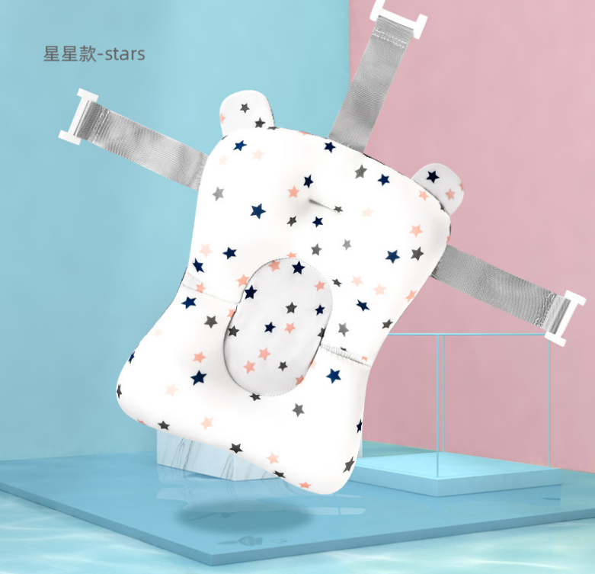
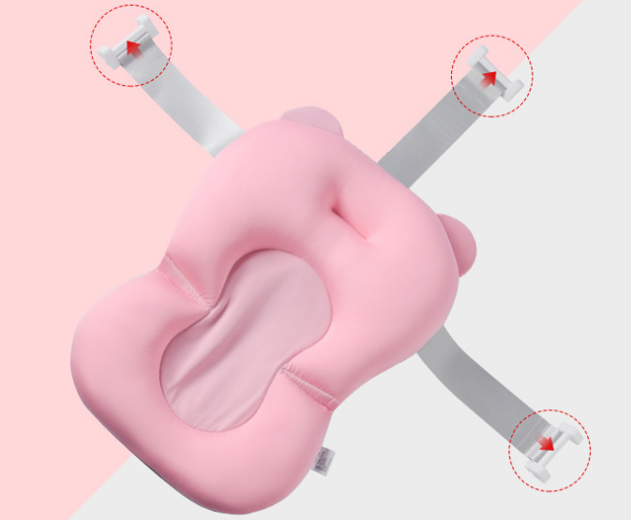
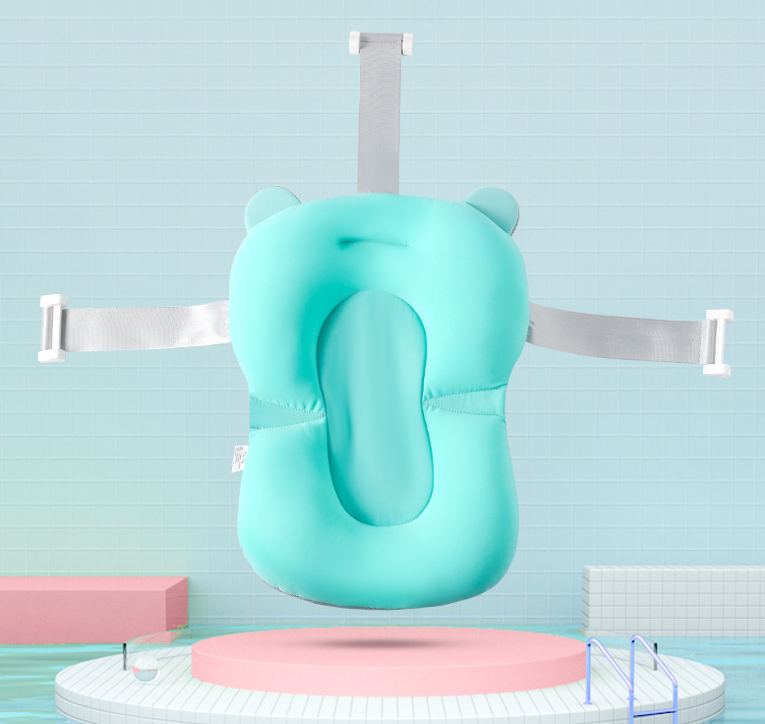
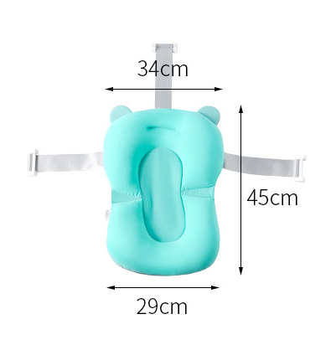
婴儿浴垫
Baby bath mat
颜色：蓝色/粉色
Color: blue/pink
材质：棉+涤纶+保丽龙+PP
Material:Cotton+polyester+styrofoam +PP
净重：0.28KG
Net weight:0.28KG
装箱数：20件
Packing number: 20 piece
毛重：0.28KG
Grossweight:0.28KG
包装尺寸：88*46*52CM
Packing size: 88*46*52CM
包装细节：OPP袋子装+入纸箱
Packing details: OPP bag+carton

