Slide 1
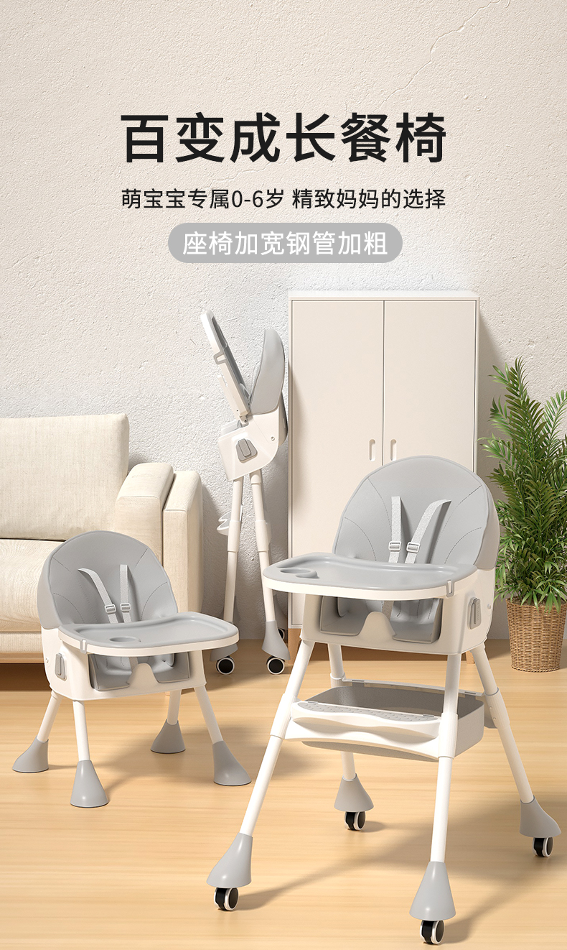
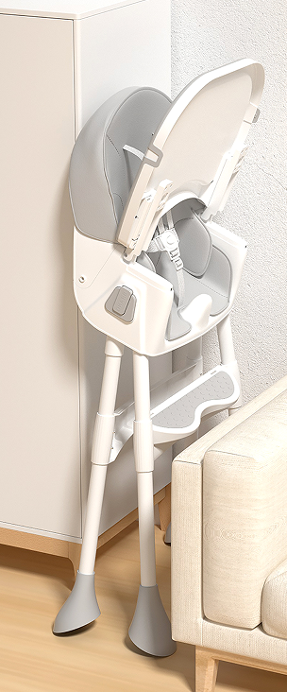
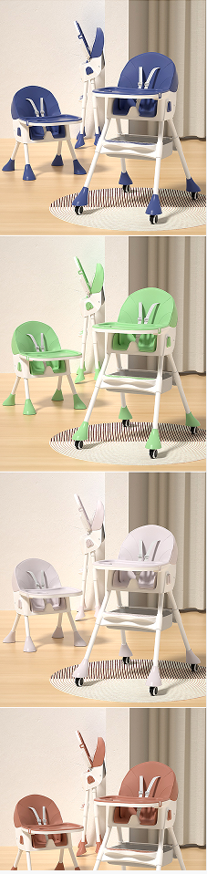
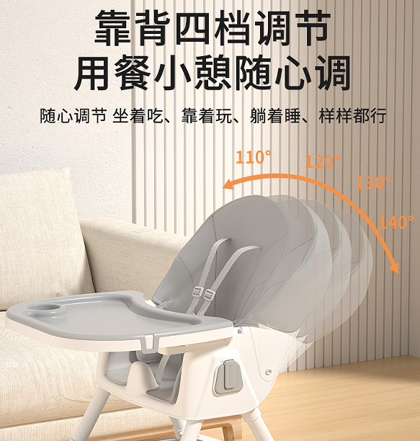
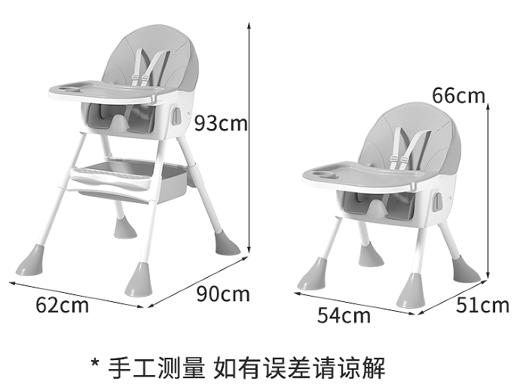
Baby folding dining chair
品名：HB-305餐椅
Name:HB-305the baby chair
材质：PP+不锈钢+PU+尼龙
Material: PP+ stainless steel +PU+ nylon
产品展开尺寸：93*62*90cm
Expanded product size: 93*62*90cm
包装尺寸：48*44*27CM
Packing: 48*44*27CM
装箱数：1件
Packing number: 1 piece
净重：4.8KG
Net weight:4.8KG
毛重：5.45kg
Gross weight: 5.45kg
执行标准：Q/HYHB 001
Implementation standard: Q/HYHB 001
单件体积：0.057m³
Single volume: 0.057m³
40Q高柜装货数量：1190套
40Q high container loading quantity: 1190 sets
定制颜色：单色整柜的数量起
Custom color: from the quantity of single color cabinet.

