Slide 1
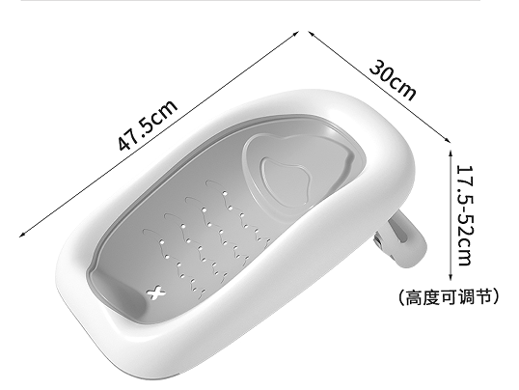
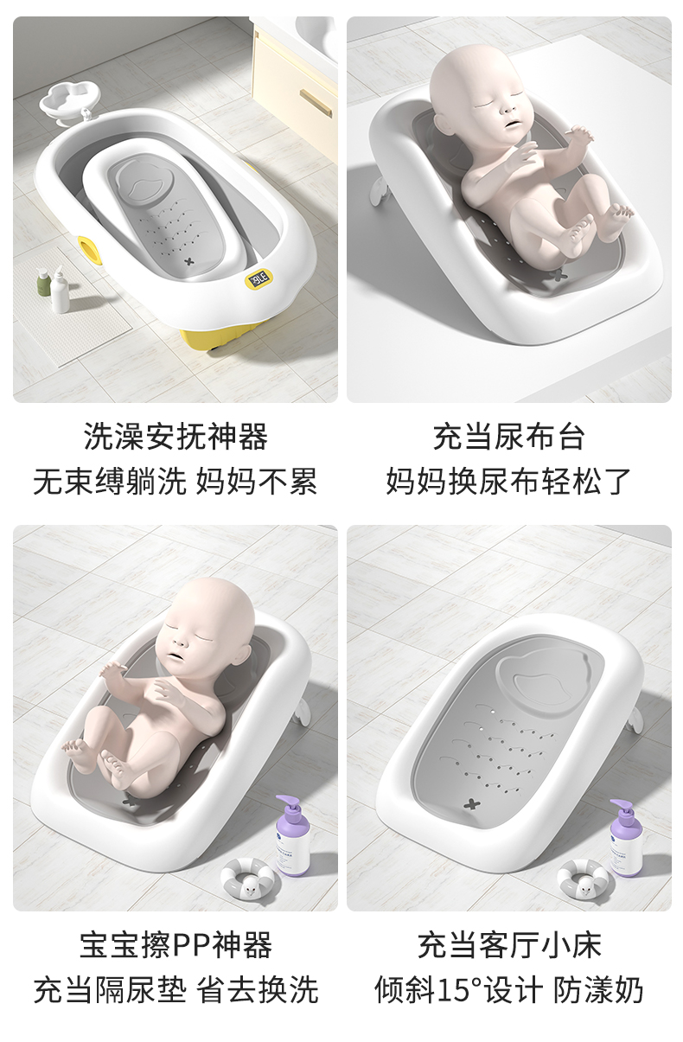

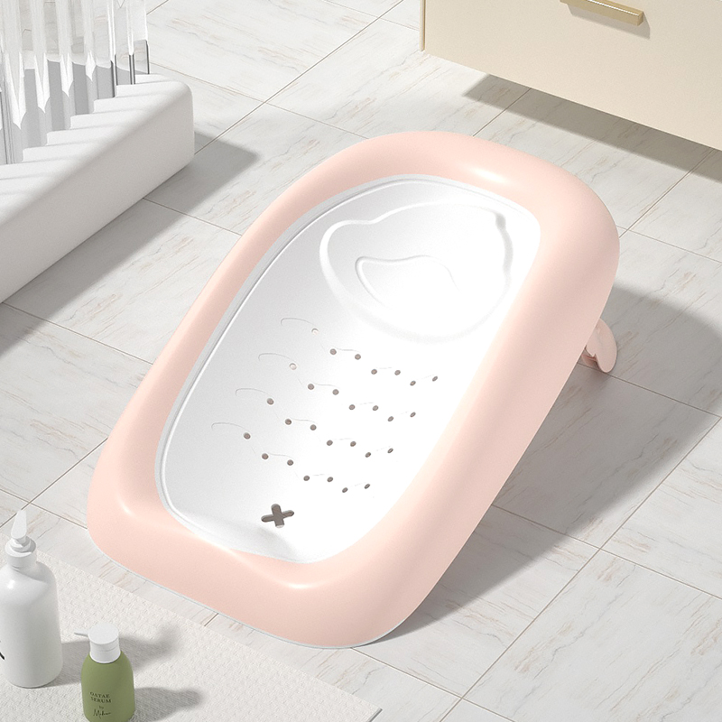
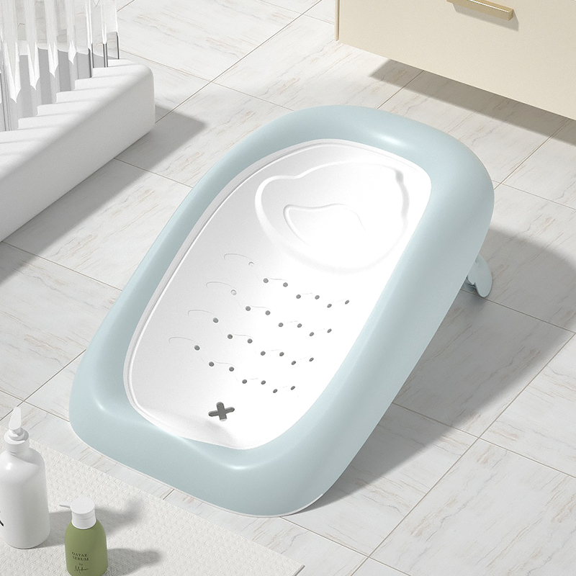
Baby bath rack
品名：YZ浴架
Name:Bath rack-YZ
材质：PP+TPE
Material: PP+TPE
包装尺寸：50.5X32X10CM
Packing: 50.5X32X10CM
装箱数：1件
Packing number: 1 piece
净重：0.51KG
Net weight: 0.51KG
毛重：0.8kg
Gross weight: 0.8kg
单件体积：0.0162m³
Single volume: 0.0162m³
40Q高柜装货数量：4200套
40Q high container loading quantity: 4200 sets
定制颜色：单色整柜的数量起
Custom color: from the quantity of single color cabinet.

